Slide 1
Better Weather
Noah Sternberg - CSC425 Final Project

Slide 2

I Hate Weather Apps.
A lot.

Slide 3
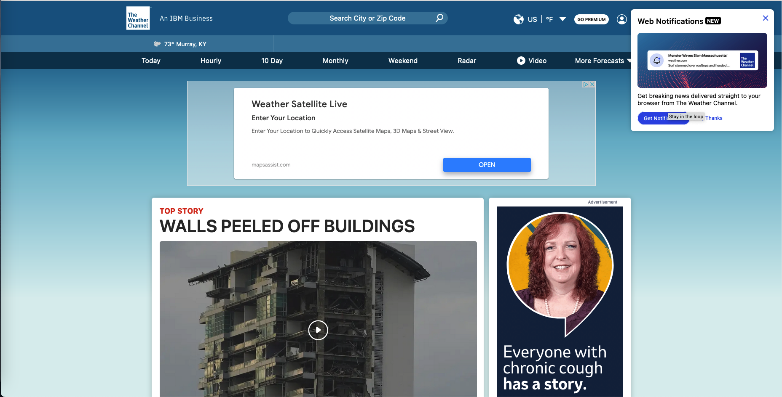
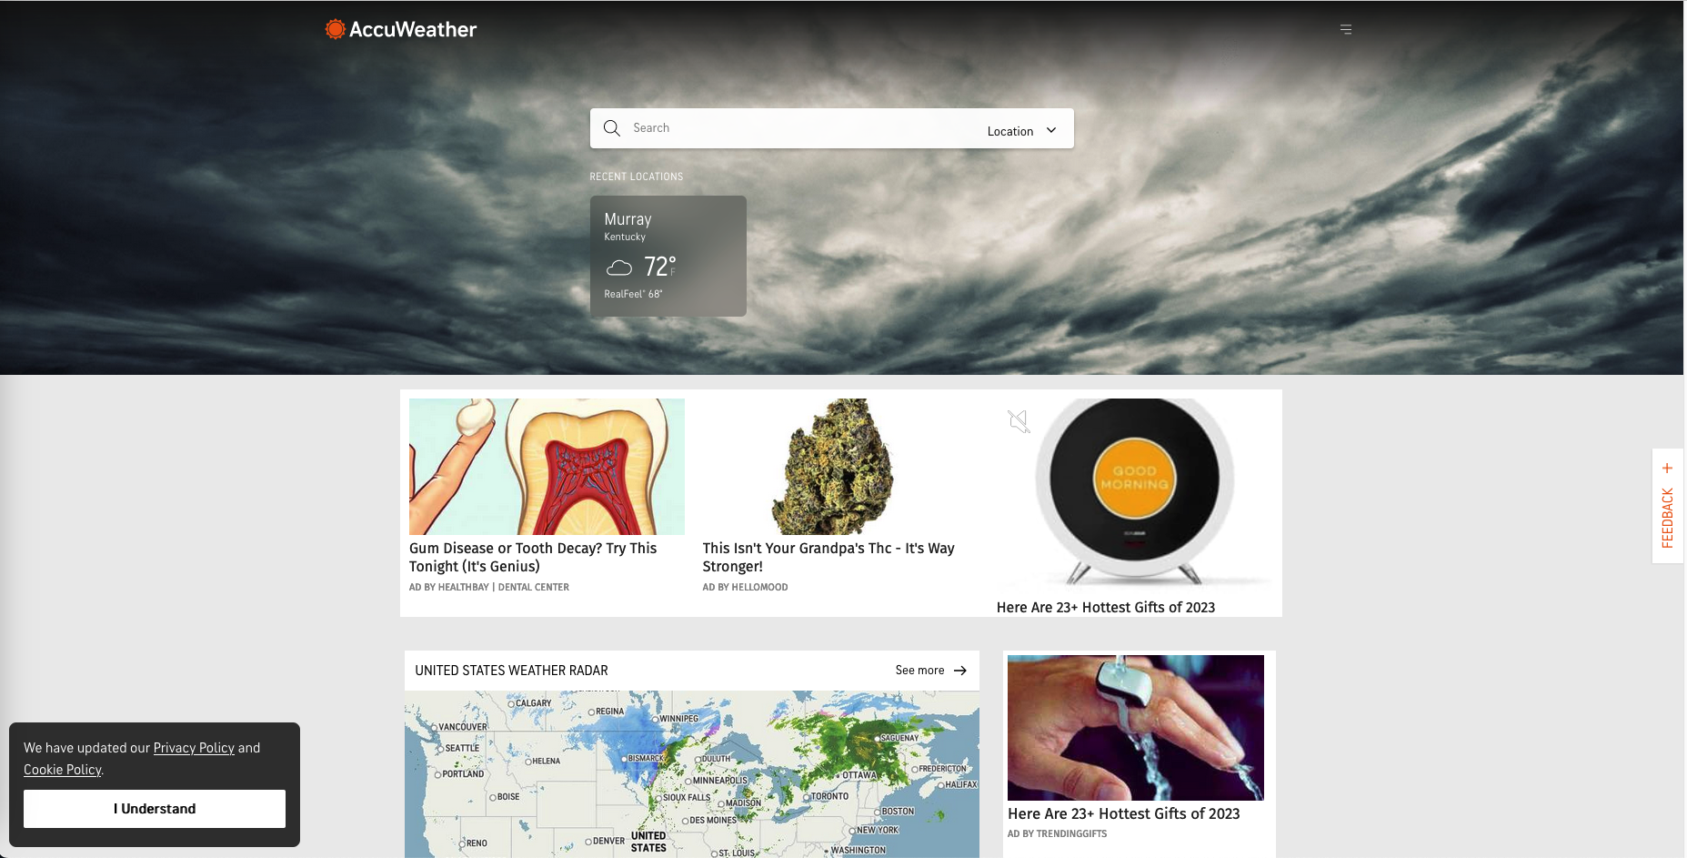
Why?

Slide 4

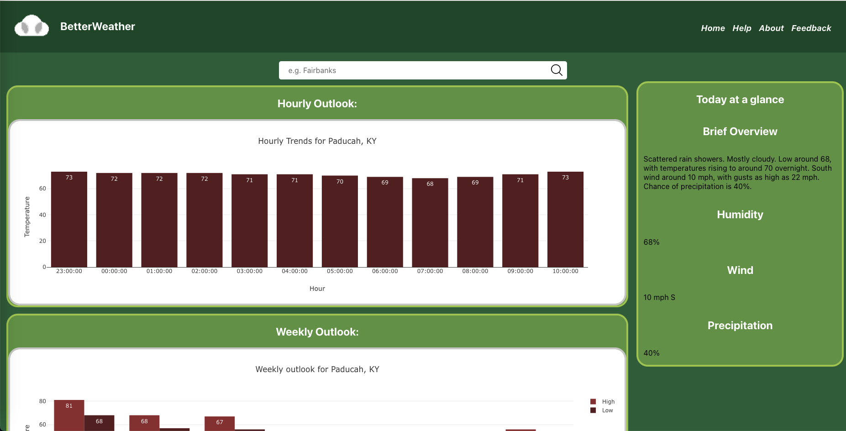
Weather, First and Foremost

Slide 5




Technical Overview
Front End
Back End
Web Services
Cloud Services
ReactJS with SCSS
National Weather Service’s Free RESTful API
National Weather Services Free RESTful API and OpenWeatherMap’s GeoCoding RESTful API
None!
(Didn’t need one)
Notes:
Explain why there are no cloud services
Explain why I didn’t need a custom back end (starting to use Spring Boot with Java, decided it wasn’t needed)

Slide 6



Behind the Scenes
Planning
Version Control
CI/CD
JIRA
Git and GitHub
GitHub Actions
Notes:
Explain why there are no cloud services
Explain why I didn’t need a custom back end (starting to use Spring Boot with Java, decided it wasn’t needed)

Slide 7
Demo
Because of the way I laid out the app, everywhere I tried hosting didn’t work, so I’m using a local build

Slide 8
It’s Free, but if it wasn’t …
Option 3
Option 2
Option 1
Ads, with a paid opt-out (I refuse to use invasive ads)
Offer some features behind a paid upgrade
Offer optional financial support (“buy me a coffee”)
Notes:
Three levels of optional financial options

Slide 9
Thank you for your time!

